Slide 1
High Performance Batch Processing
By Mahmoud Ben Hassine & Michael Minella
@_benas_ & @michaelminella

Slide 2


HIGH PERFORMANCE
BATCH PROCESSING

Slide 3

MICHAEL MINELLA
Lead | OSS Spring Team
JSR-352 | Expert Group Member
Author | The Definitive Guide to Spring Batch
 | Pro Spring Batch
Speaker | JavaOne Rockstar
 | Java Champion
Podcast | OffHeap Curmudgeon
Twitter | @michaelminella
 | @OffHeap

Slide 4
MAHMOUD BEN HASSINE
Founder – JEasy including
EasyBatch (jeasy.org)
Committer - Spring Batch
Blogger – https://benas.github.io
Github - @benas
Twitter - @_benas_

Slide 5


Slide 6

SLIDES AND CODE
WILL BE ON GITHUB SOON
https://github.com/mminella/scaling-demos
Notes:
S1P 2018 branch was used in the presentation at Spring One Platform 2018

Slide 7

Notes:
Please ask questions when you have them

Slide 8

LAY OF THE LAND

Slide 9

SPRING FRAMEWORK

Slide 10

SPRING BATCH

Slide 11

SPRING CLOUD

Slide 12
SPRING CLOUD TASK

Slide 13

Notes:
Today we’re going to look at the most exciting area of IT

Slide 14

The Definitive Guide To Spring Batch
Notes:
Batch processing

Slide 15
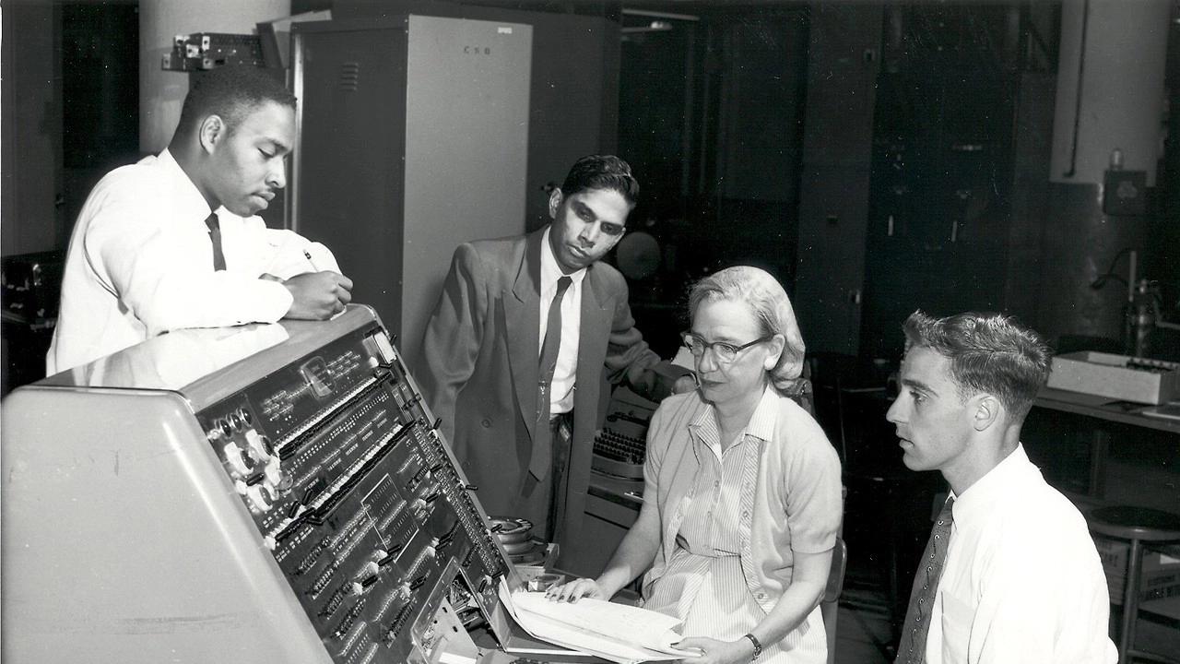
Notes:
While batch processing may be old

Slide 16

EFFECIENT USE OF
RESOURCES

Slide 17

SCALING SPRING BATCH
IS EASY

Slide 18

BATCH APPLICATIONS CAN
EVOLVE

Slide 19
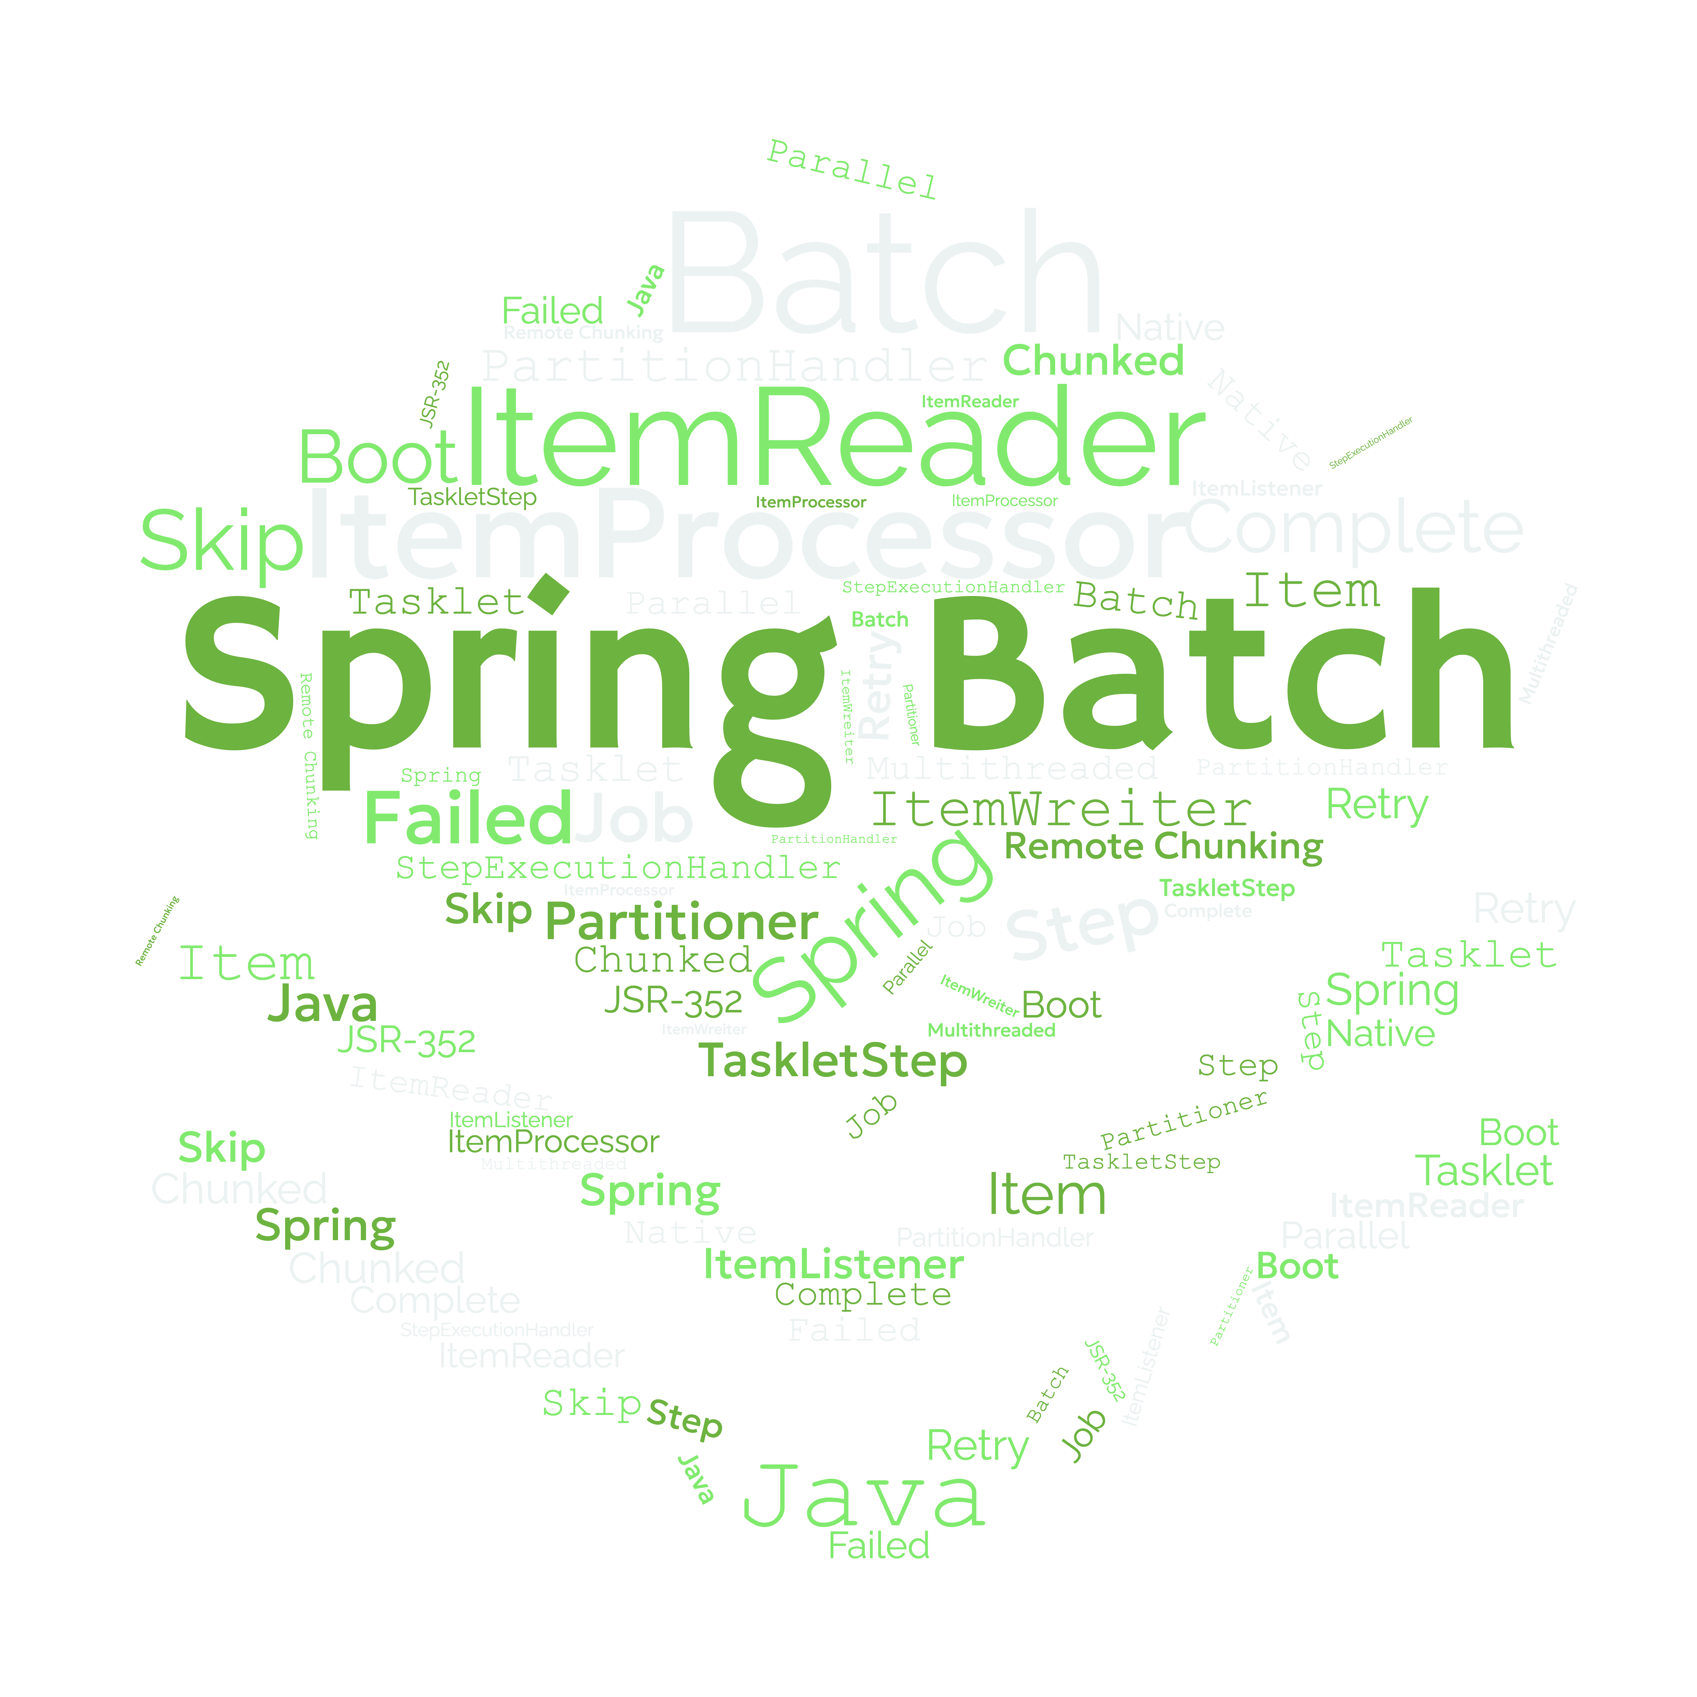
LINGO

Slide 20

JOB

Slide 21
STEP

Slide 22

TASKLET

Slide 23

CHUNK

Slide 24

ITEM

Slide 25
Step1
Step2
Step3
ItemReader
ItemReader
ItemReader
ItemProcessor
ItemProcessor
ItemProcessor
ItemWriter
ItemWriter
ItemWriter

Slide 26

METHODS OF SCALING
BATCH PROCESSES

Slide 27
1
MULTITHREADED STEPS

Slide 28
2
PARALLEL STEPS

Slide 29
3
ASYNC
ITEMPROCESSOR/ITEMWRITER

Slide 30
4
PARTITIONING

Slide 31
5
REMOTE CHUNKING

Slide 32




Transaction Files
Import Process

Slide 33

MULTITHREADED
STEPS

Slide 34
ItemReader
ItemReader
ItemProcessor
ItemReader
ItemProcessor
ItemReader
ItemWriter
ItemProcessor
ItemReader
ItemWriter
ItemProcessor
ItemReader
ItemWriter
ItemProcessor
ItemReader
ItemWriter
ItemProcessor
ItemReader
ItemWriter
ItemProcessor
ItemWriter
ItemProcessor
ItemWriter
ItemWriter

Slide 35
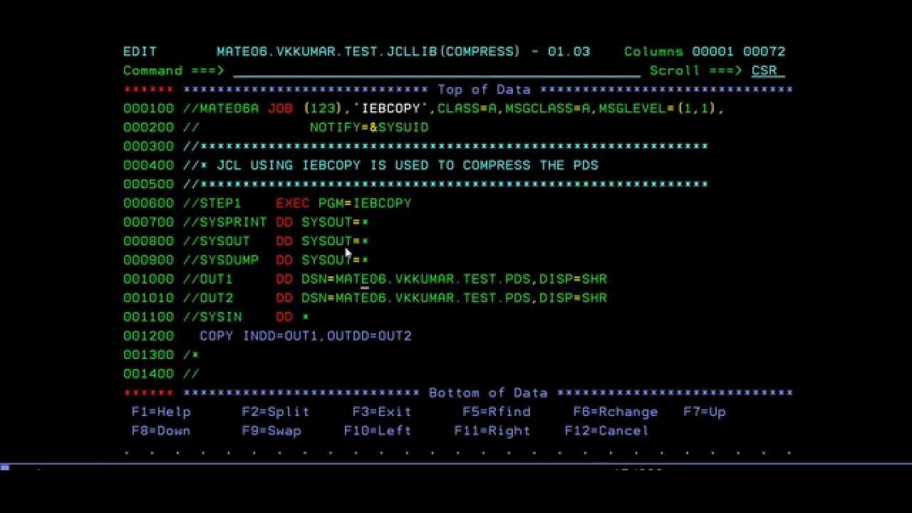
SHOW ME THE
CODE!

Slide 36
PARALLEL STEPS

Slide 37
ItemReader
ItemProcessor
ItemWriter
ItemReader
ItemReader
ItemProcessor
ItemProcessor
ItemWriter
ItemWriter

Slide 38
SHOW ME THE
CODE!

Slide 39

ASYNC ITEMPROCESSOR
& ITEMWRITER

Slide 40
ItemReader
ItemProcessor
ItemProcessor
ItemProcessor
ItemProcessor
ItemProcessor
ItemProcessor
ItemProcessor
ItemWriter

Slide 41
SHOW ME THE
CODE!

Slide 42

PARTITIONING

Slide 43
Partitioner
PartitionHandler
ItemReader
ItemReader
ItemReader
ItemProcessor
ItemProcessor
ItemProcessor
ItemWriter
ItemWriter
ItemWriter

Slide 44


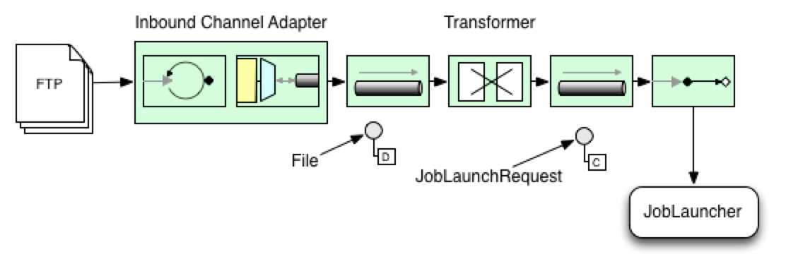

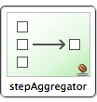

request
outboundAdapter
Partition
Handler
Manager
reply
aggregator
staging
inboundAdapter
Worker
Remote
Step
request
inboundAdapter
serviceActivator
staging
outboundAdapter

Slide 45
SHOW ME THE
CODE!

Slide 46

REMOTE
CHUNKING

Slide 47
ItemReader
ItemWriter
ItemProcessor
ItemProcessor
ItemProcessor
ItemWriter
ItemWriter
ItemWriter

Slide 48
request
outboundAdapter
MessageChannel
ChunkWriter
Partition
Handler
Manager
reply
inboundAdapter
Worker
Chunk Handler
request
inboundAdapter
Remote
Step
serviceActivator
staging
outboundAdapter

Slide 49
SHOW ME THE
CODE!

Slide 50
USING SPRING BATCH

Slide 51
YOU CAN EVOLVE YOUR
BATCH APPLICATIONS

Slide 52
TO DEVELOP
HIGH PERFORMANCE
BATCH APPLICATIONS

Slide 54

> Stay Connected.
https://github.com/spring-projects-spring-batch
@s1p
#springone

